Slide 1
Optimization methods

Slide 2
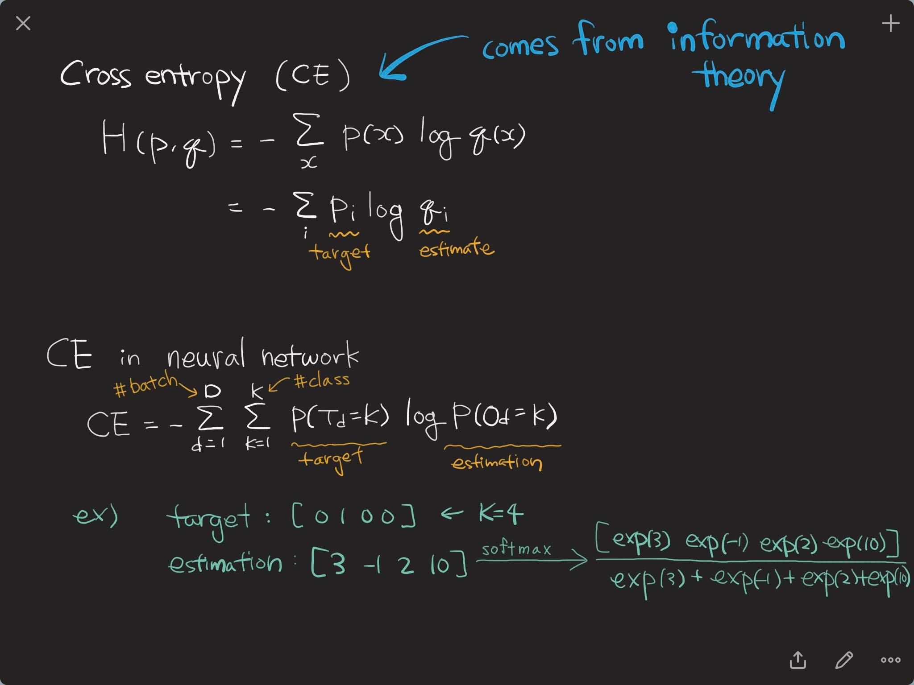
Cross entropy

Slide 3
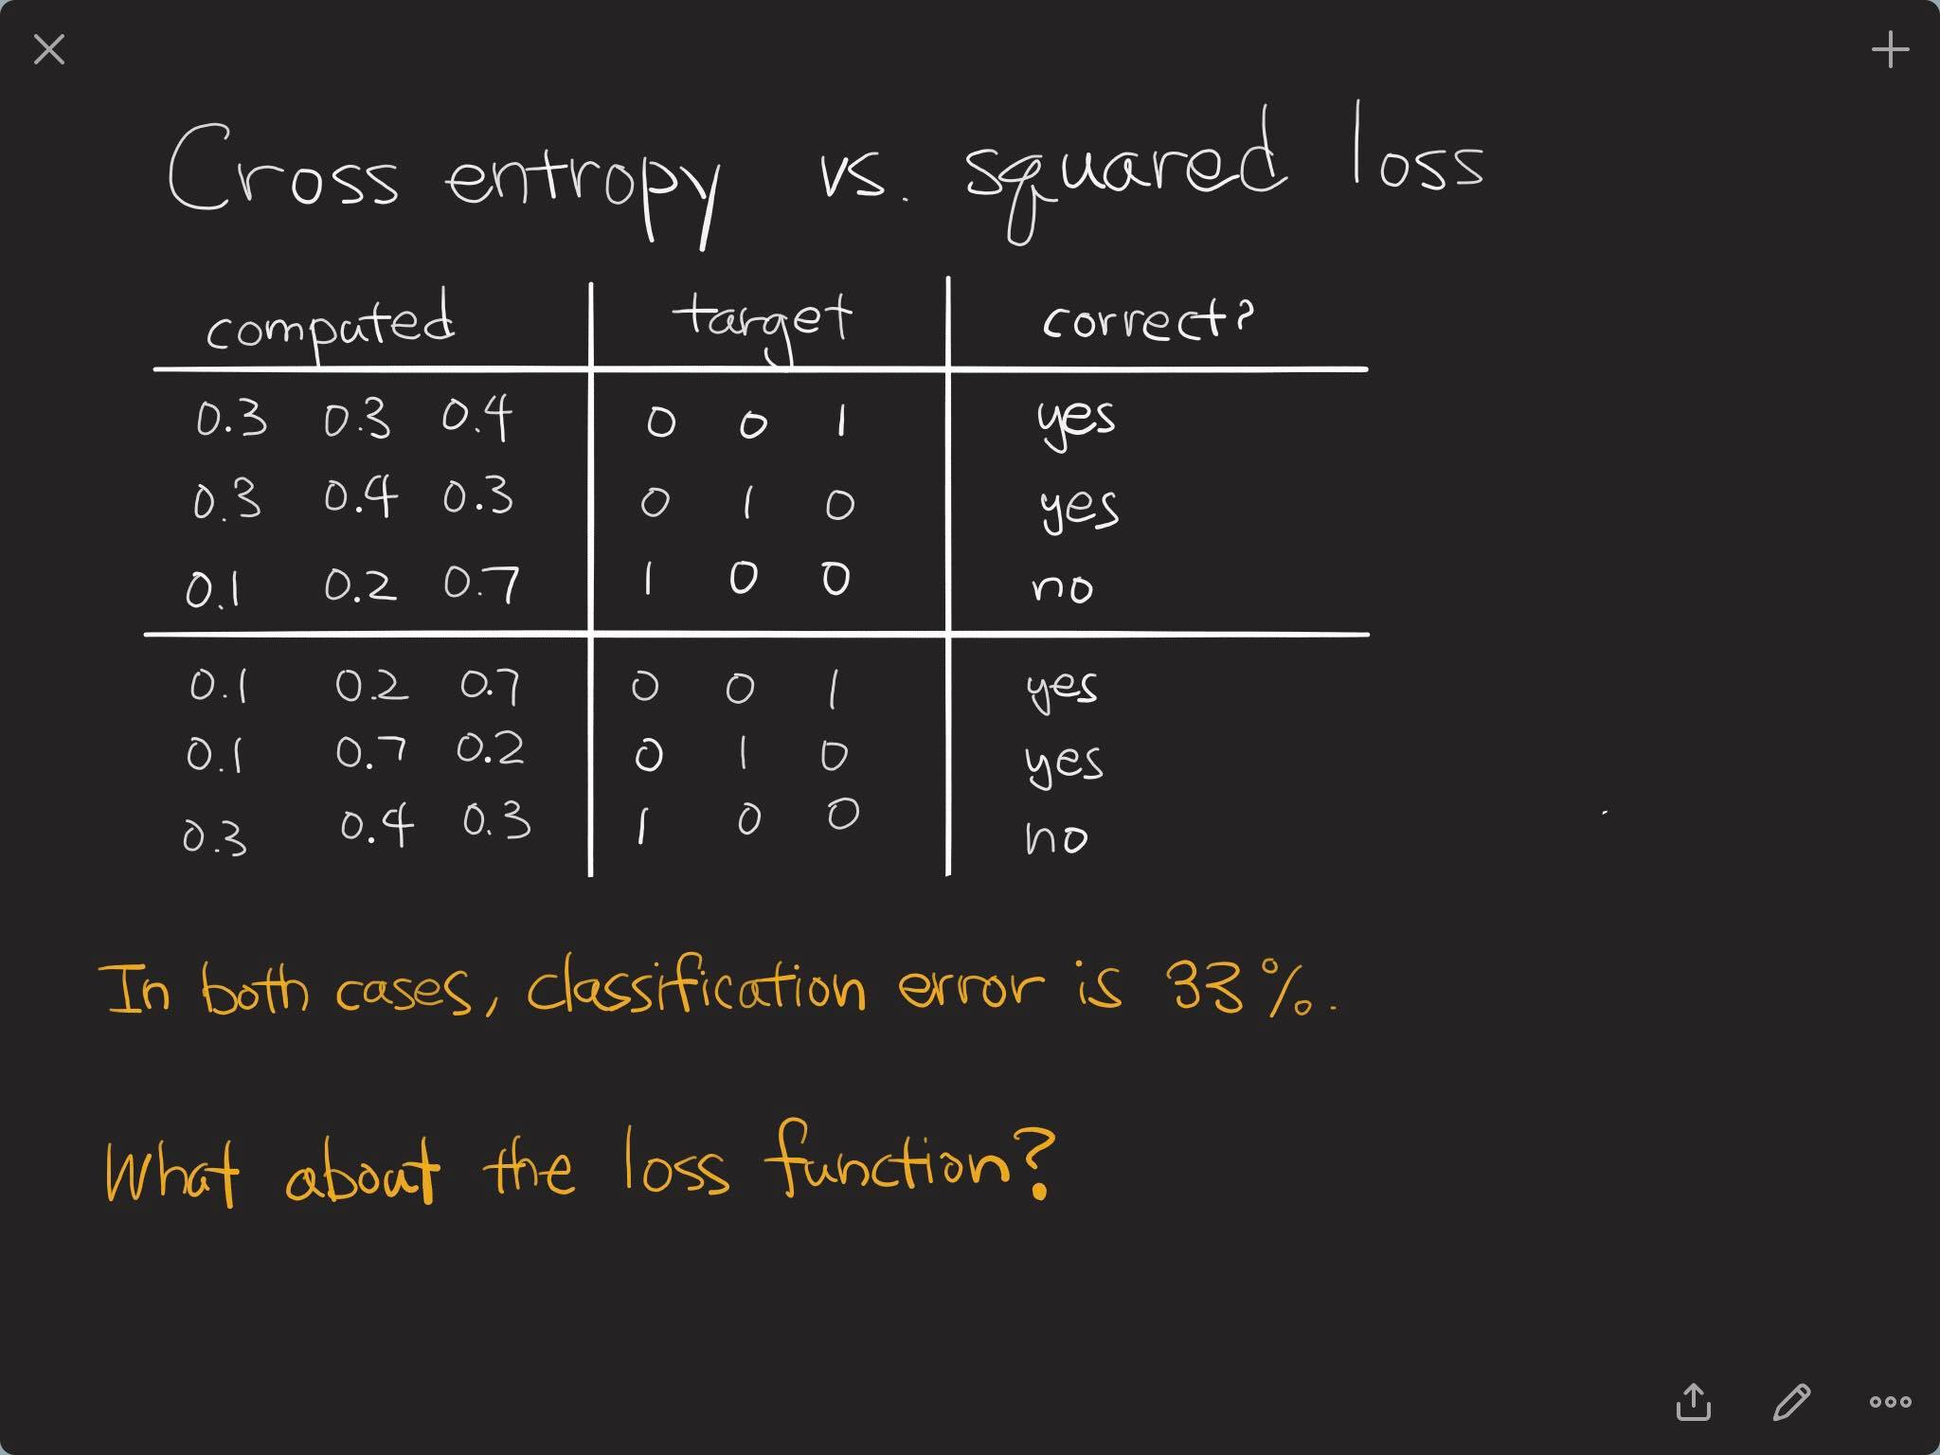
Cross entropy vs. squared loss

Slide 4
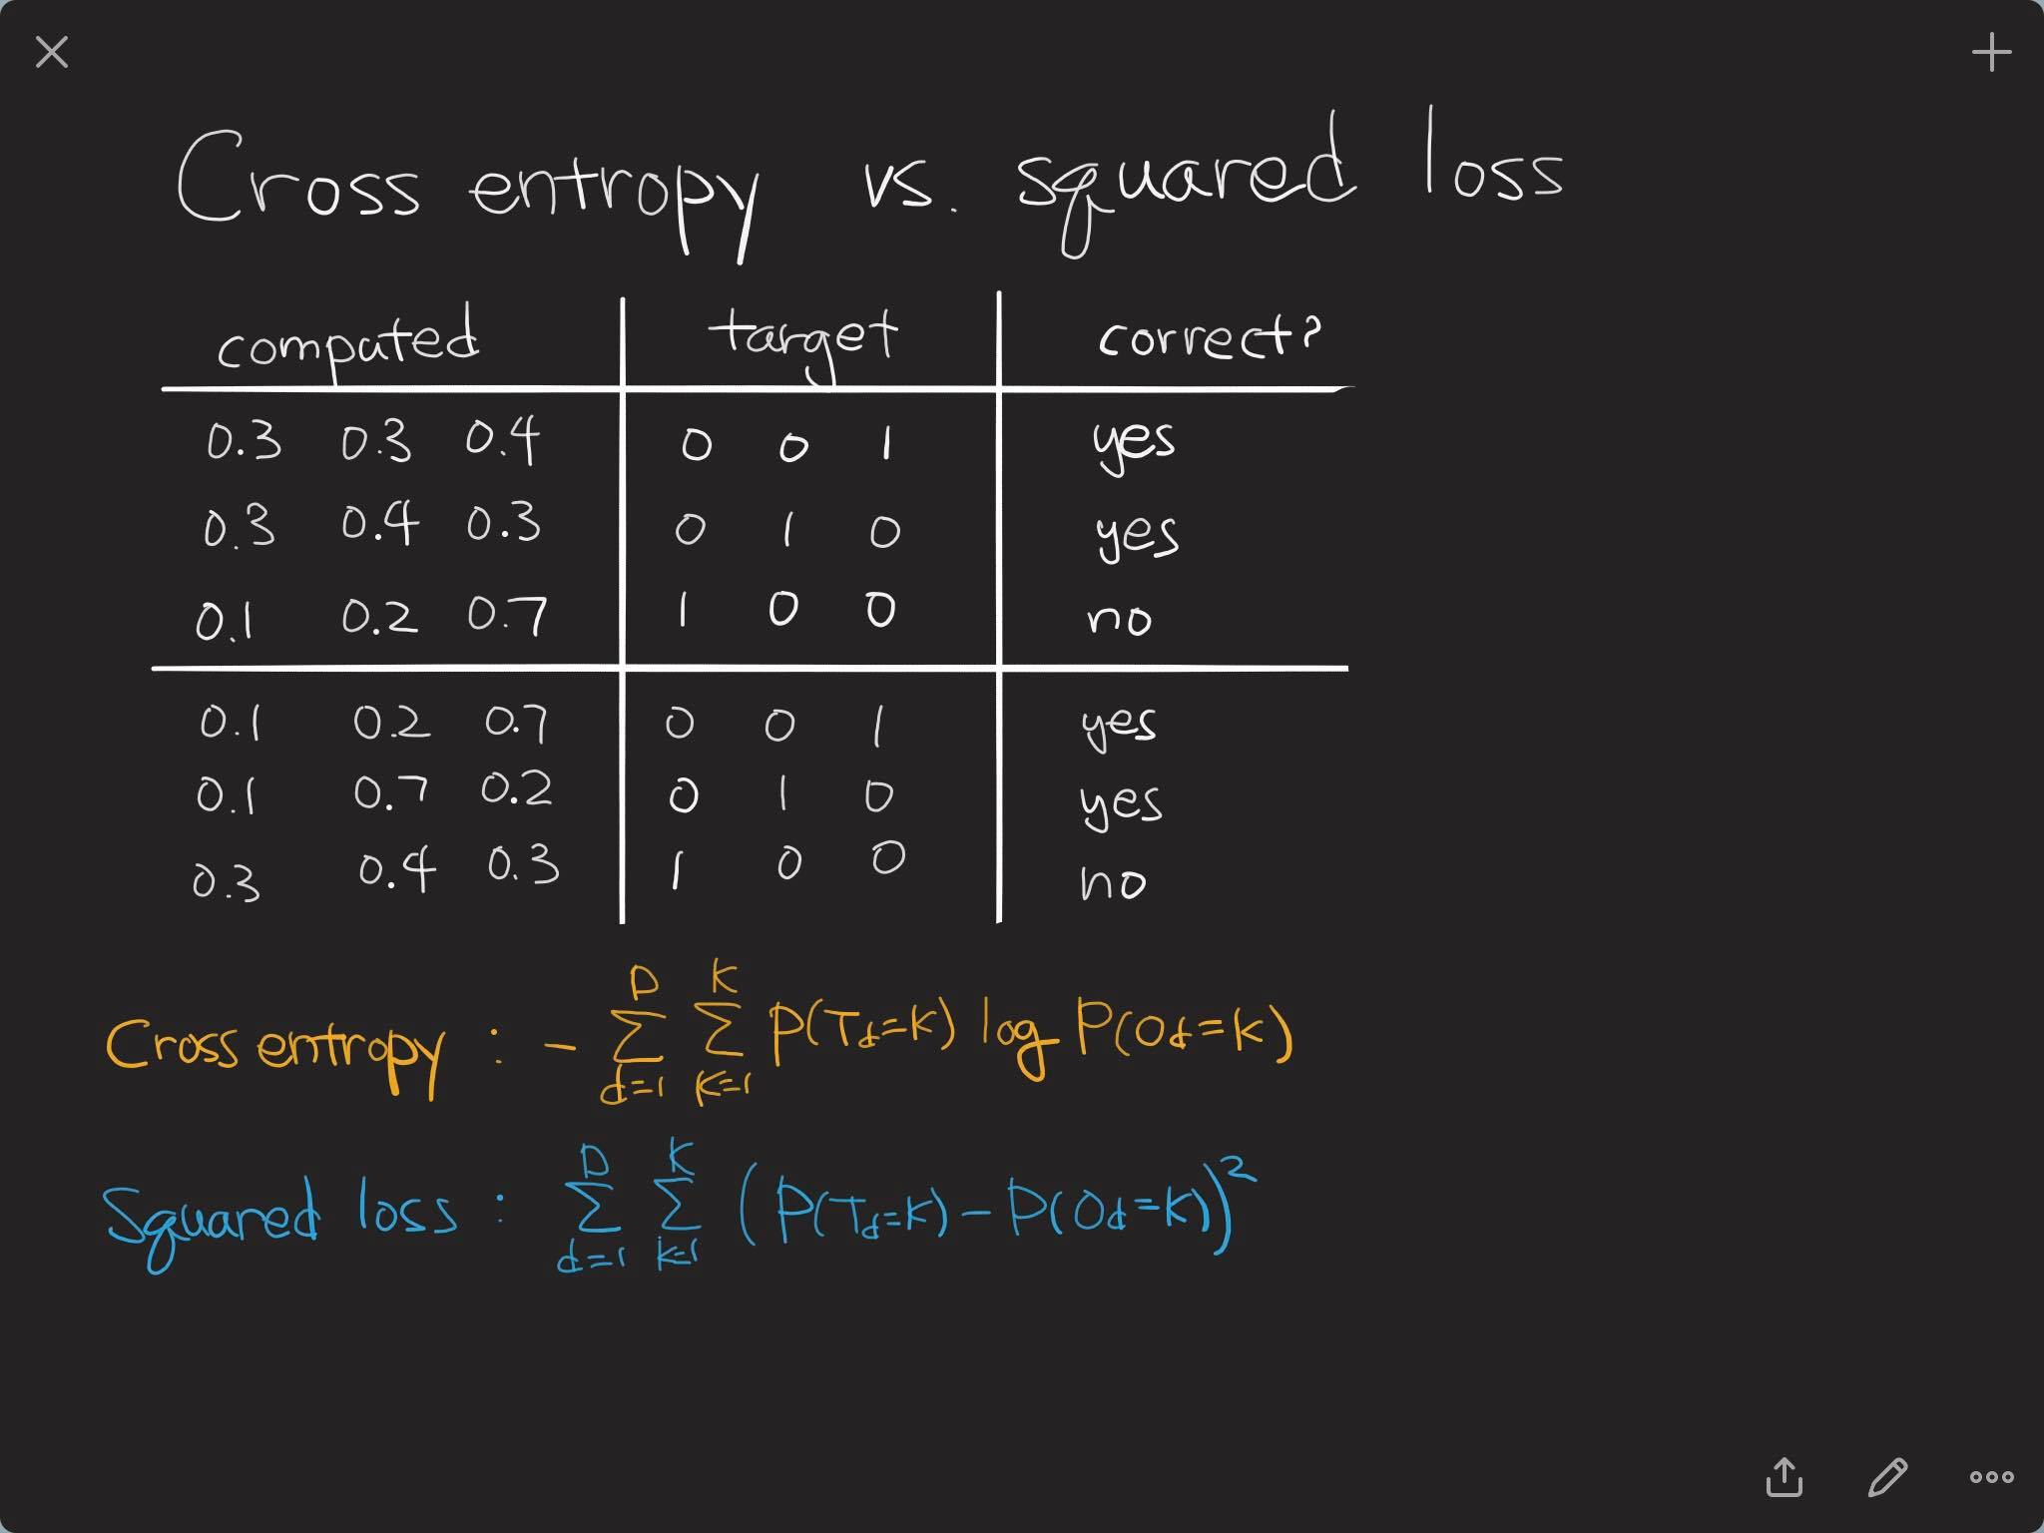
Cross entropy vs. squared loss

Slide 5
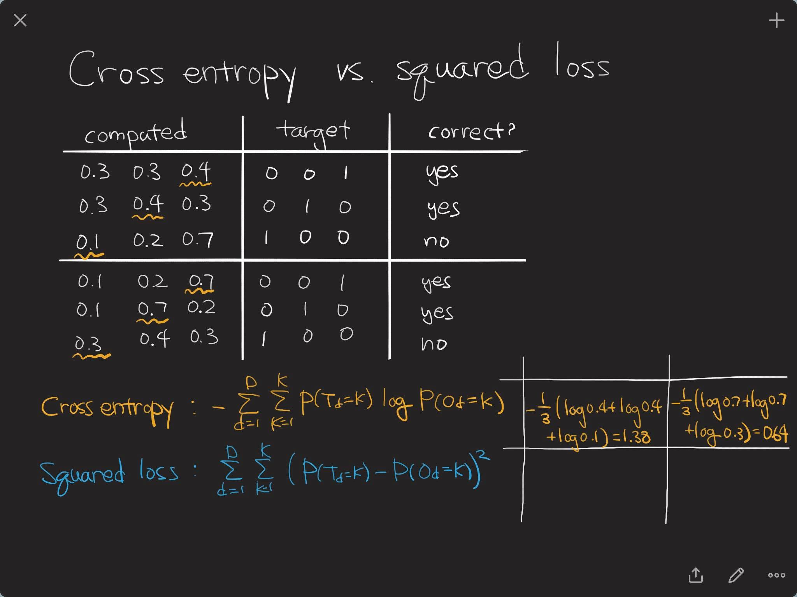
Cross entropy vs. squared loss

Slide 6
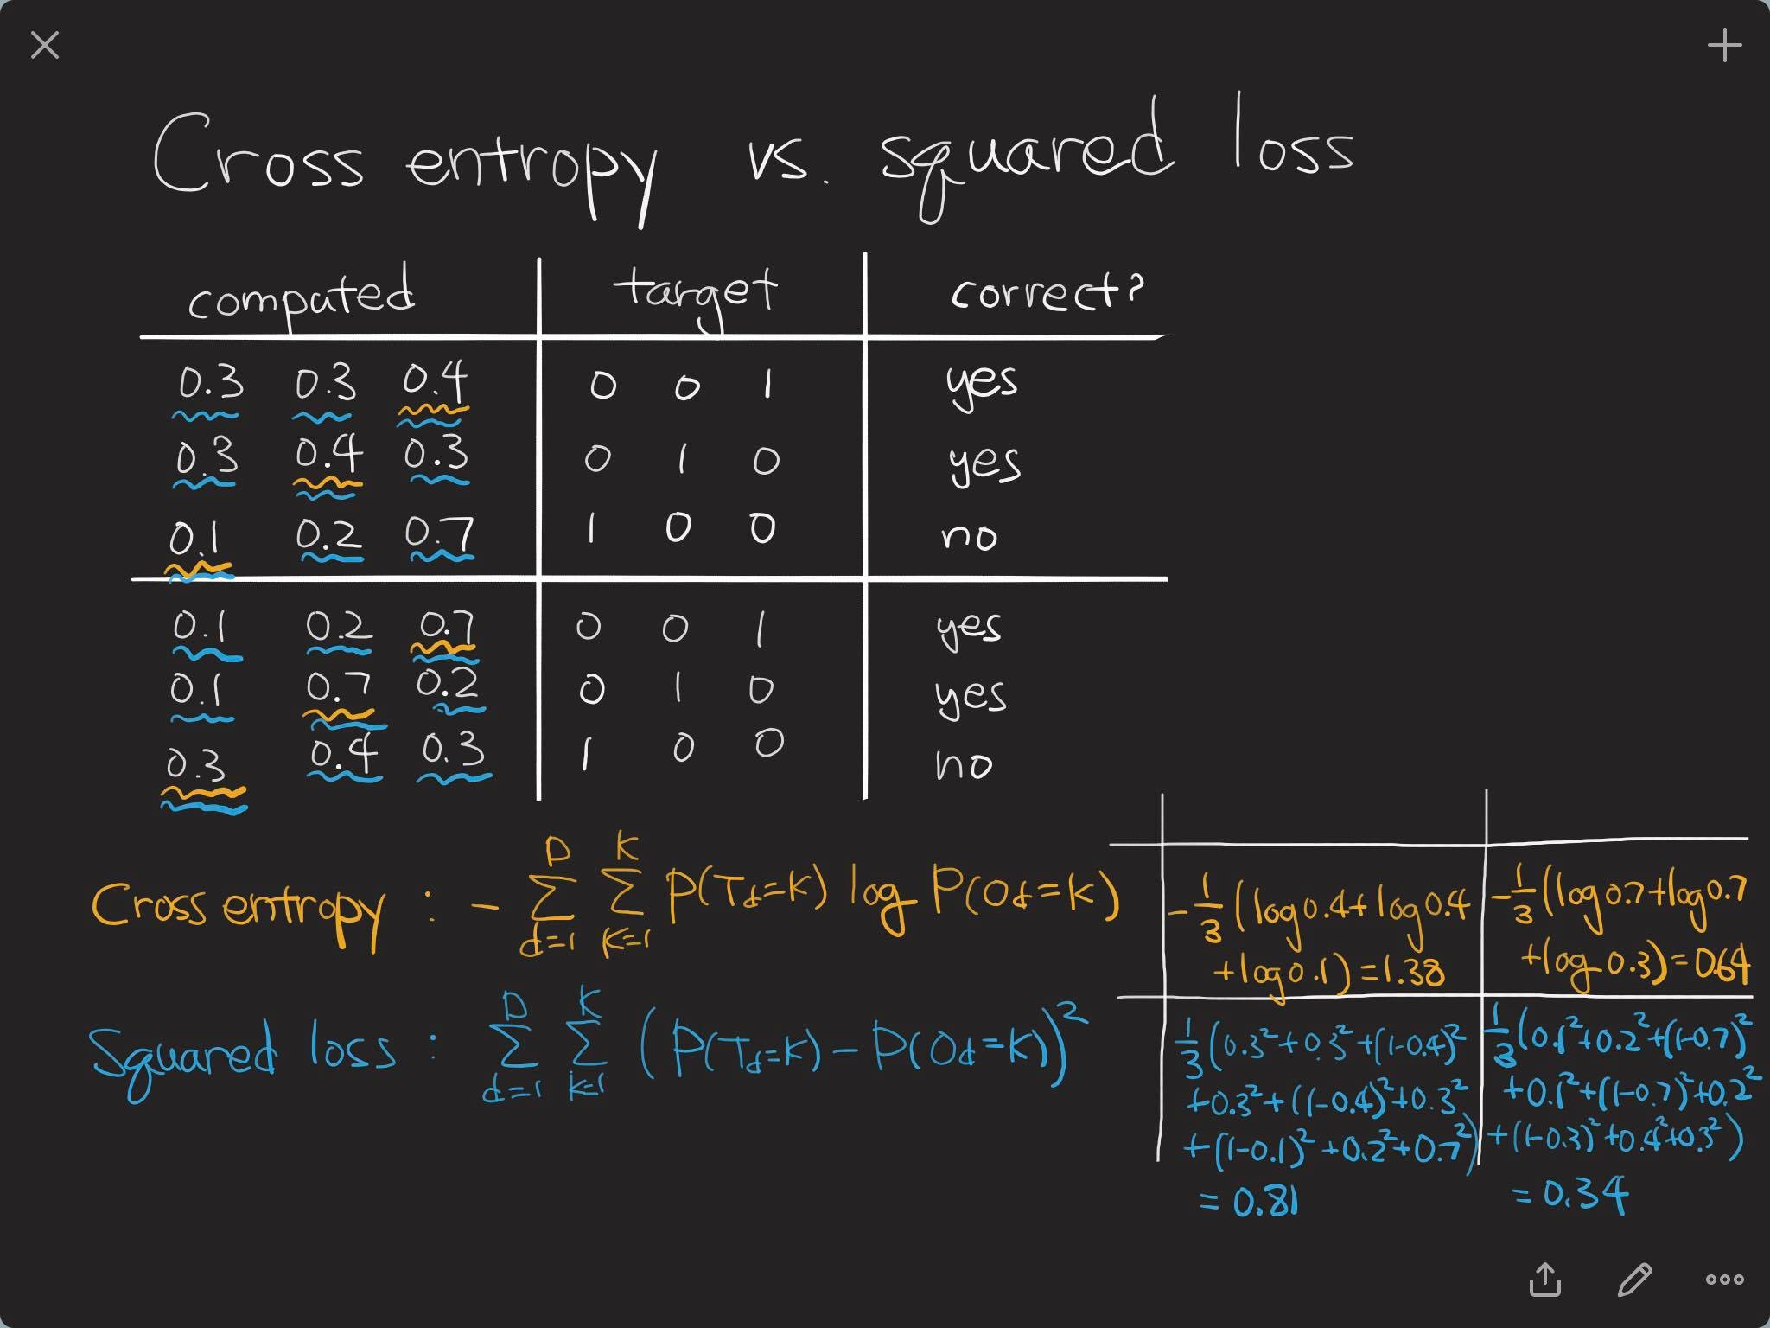
Cross entropy vs. squared loss

Slide 7
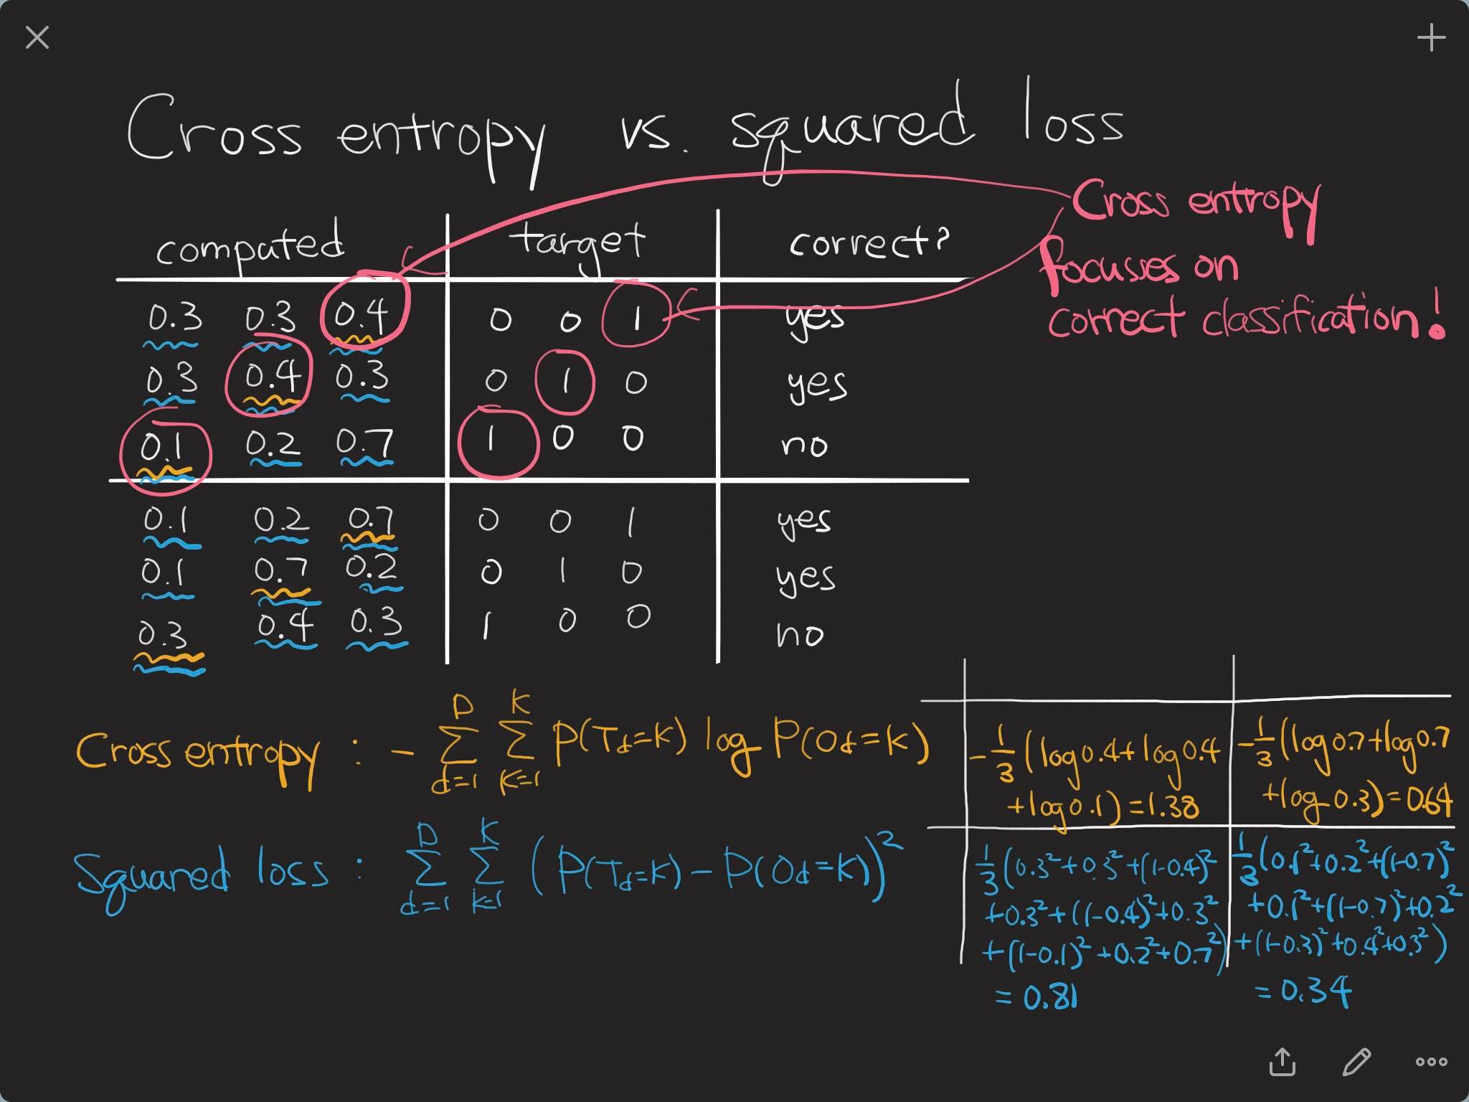
Cross entropy vs. squared loss

Slide 8
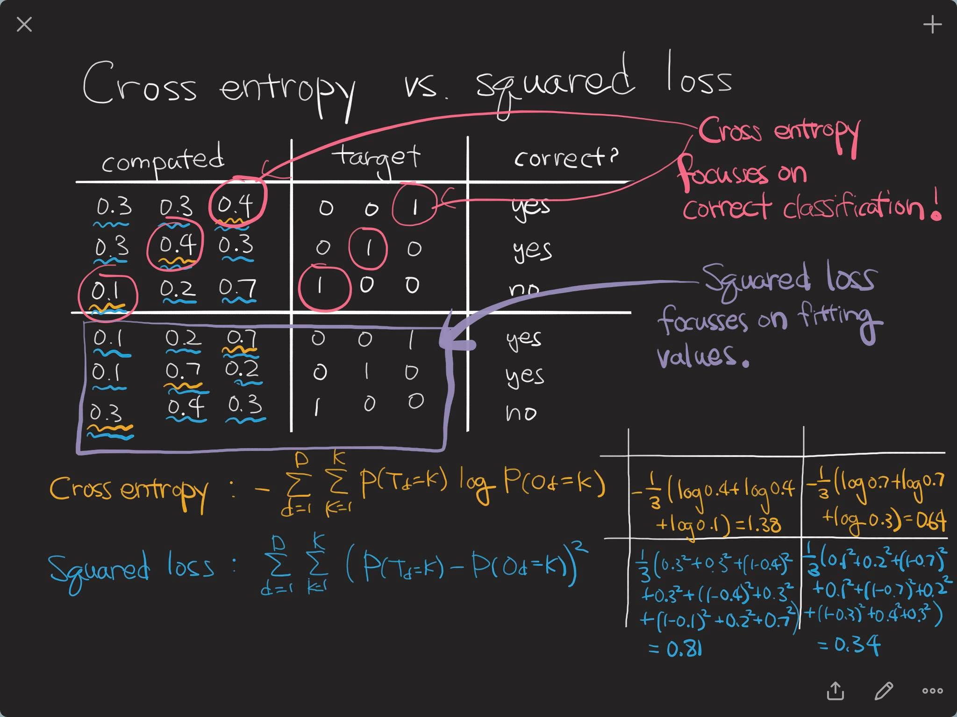
Cross entropy vs. squared loss

Slide 9
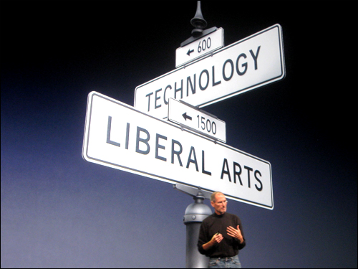
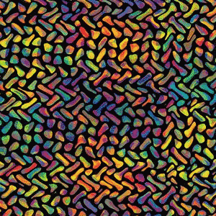
Optimization?

Slide 10
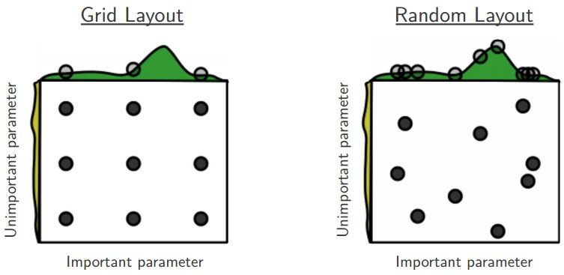
Random search?

Slide 11
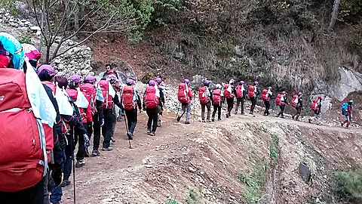
Gradient descent?

Slide 12
Gradient descent?
There are three variants of gradient descent
Differ in how much data we use to compute gradient
We make a trade-off between the accuracy and computing time

Slide 13
Batch gradient descent
In batch gradient decent, we use the entire training dataset to compute the gradient.

Slide 14
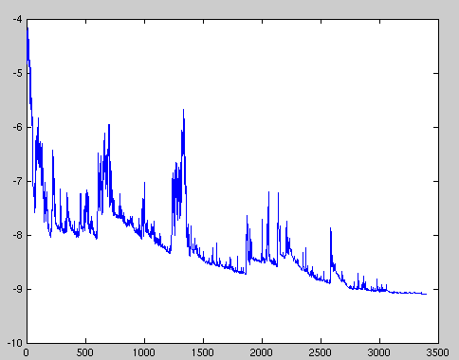
Stochastic gradient descent
In stochastic gradient descent (SGD), the gradient is computed from each training sample, one by one.

Slide 15

Mini-batch gradient decent
In mini-batch gradient decent, we take the best of both worlds.
Common mini-batch sizes range between 50 and 256 (but can vary).

Slide 16
Challenges
Choosing a proper learning rate is cumbersome.
→ Learning rate schedule
Avoiding getting trapped in suboptimal local minima

Slide 17
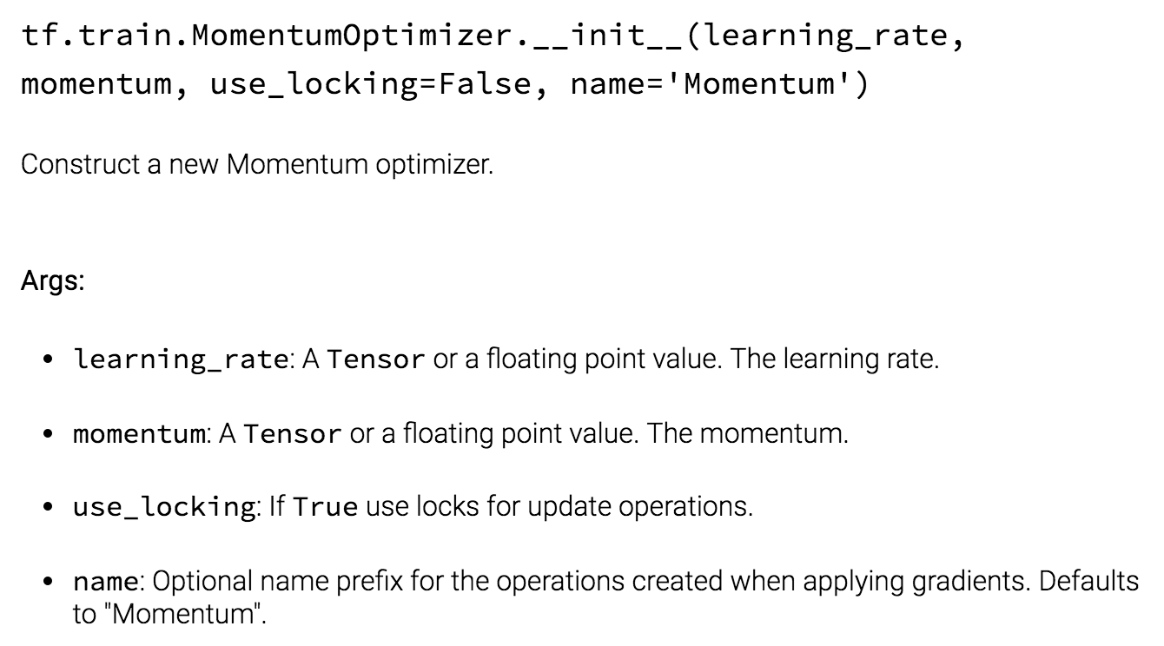
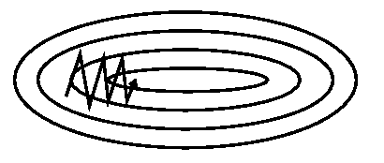
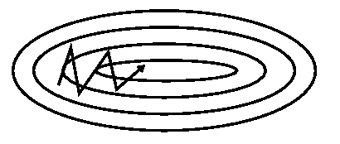
Momentum

Slide 18
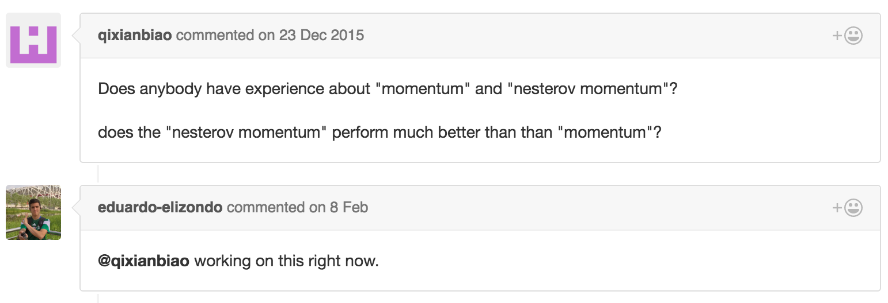
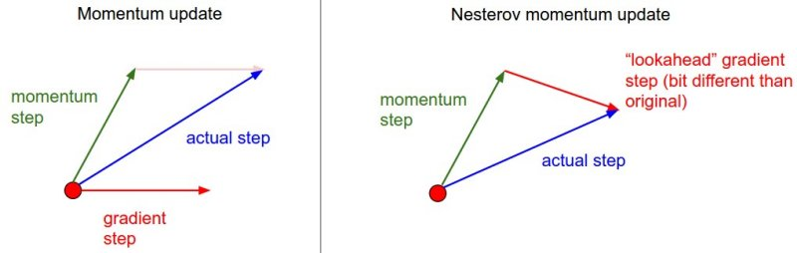
Nesterov accelerated gradient

Slide 19
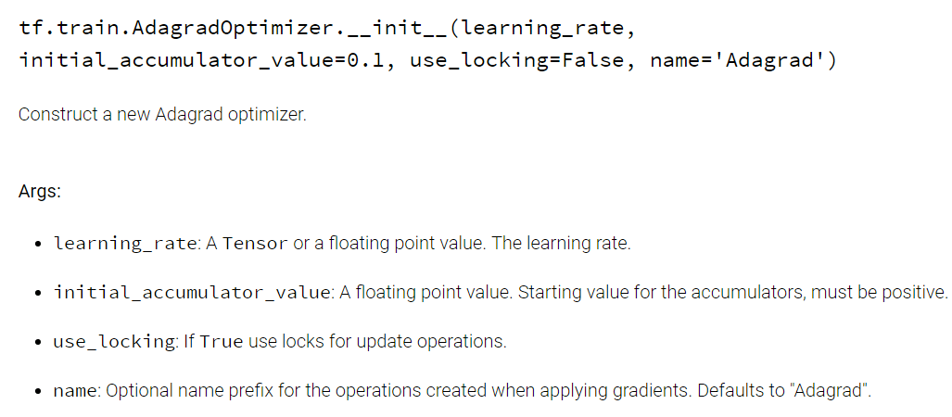
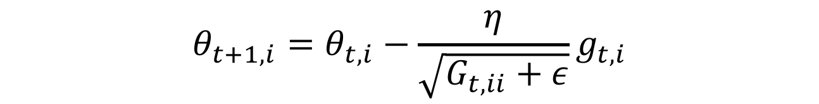
Adagrad
It adapts the learning rate to the parameters, performing larger updates for infrequent and smaller updates for frequent parameters.
$$θ_{t+1, i}=θ_{t, i}−\frac{η}{\sqrt{G_{t, ii}+ε}}g_{t, i}$$
Performing larger updates for infrequent and smaller updates for frequent parameters.

Slide 20
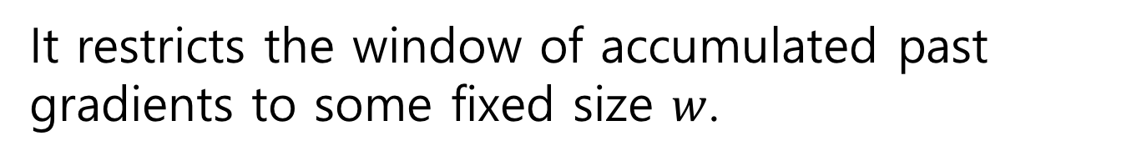
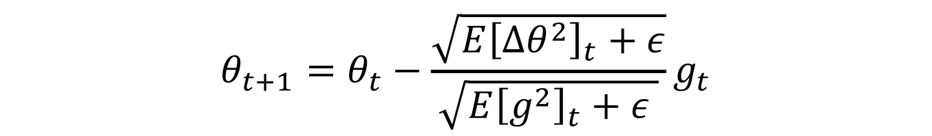
Adadelta
Adadelta is an extension of Adagrad that seeks to reduce its monotonically decreasing learning rate.
It restricts the window of accumulated past gradients to some fixed size $w$.
$$E{\left[g^{2}\right]}_{t}=γE{\left[g^{2}\right]}_{t−1}+\left(1−γ\right)g_{t}^{2}$$
$$E{\left[∆θ^{2}\right]}_{t}=γE{\left[∆θ^{2}\right]}_{t−1}+\left(1−γ\right)∆θ_{t}^{2}$$
No learning rate!
$$θ_{t+1}=θ_{t}−\frac{\sqrt{E{\left[∆θ^{2}\right]}_{t}+ε}}{\sqrt{E{\left[g^{2}\right]}_{t}+ε }}g_{t}$$

Slide 21
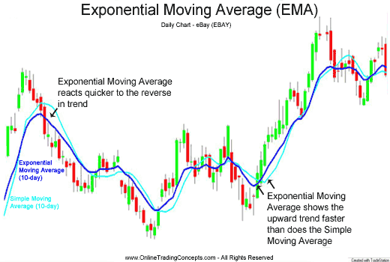
Exponential moving average

Slide 22
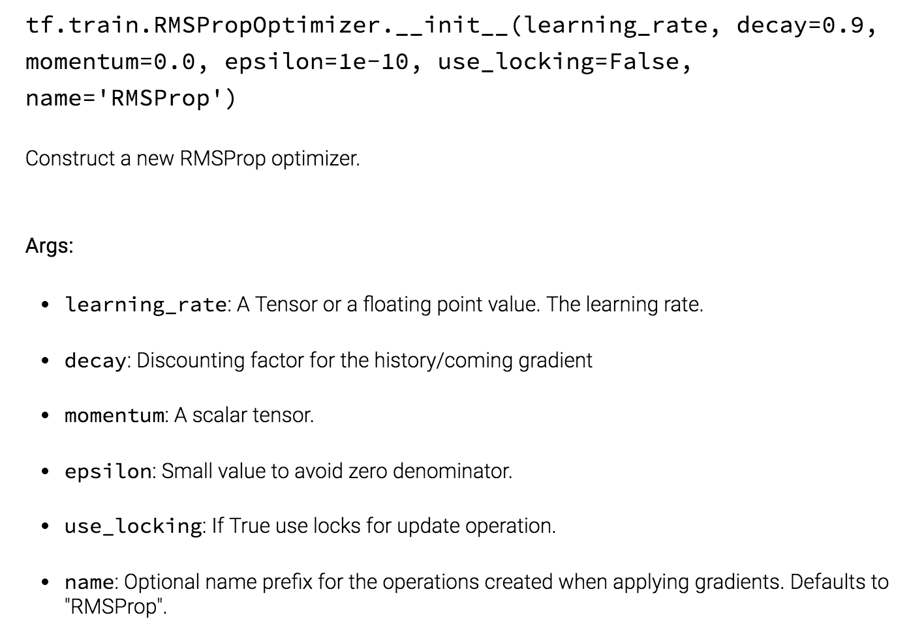
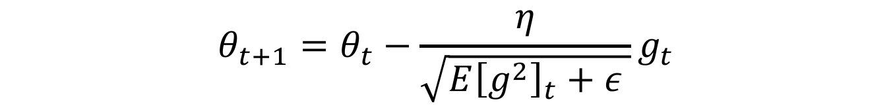
RMSprop
RMSprop is an unpublished, adaptive learning rate method proposed by Geoff Hinton in his lecture..
$$E{\left[g^{2}\right]}_{t}=γE{\left[g^{2}\right]}_{t−1}+\left(1−γ\right)g_{t}^{2}$$
$$θ_{t+1}=θ_{t}−\frac{η}{\sqrt{E{\left[g^{2}\right]}_{t}+ε }}g_{t}$$

Slide 23
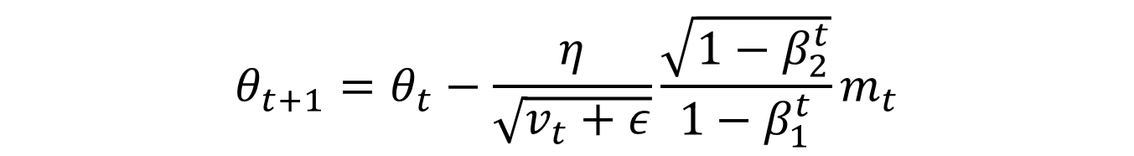
Adam
Adaptive Moment Estimation (Adam) stores both exponentially decaying average of past gradients and and squared gradients.
$$m_{t}=β_{1}m_{t−1}+\left(1−β_{1}\right)g_{t}$$
Momentum
$$v_{t}=β_{2}v_{t−1}+\left(1−β_{2}\right)g_{t}^{2}$$
Running average of gradient squares
$$θ_{t+1}=θ_{t}−\frac{η}{\sqrt{v_{t}+ε}}{\frac{\sqrt{1−β_{2}^{t}}}{1−β_{1}^{t}}m}_{t}$$

Slide 24
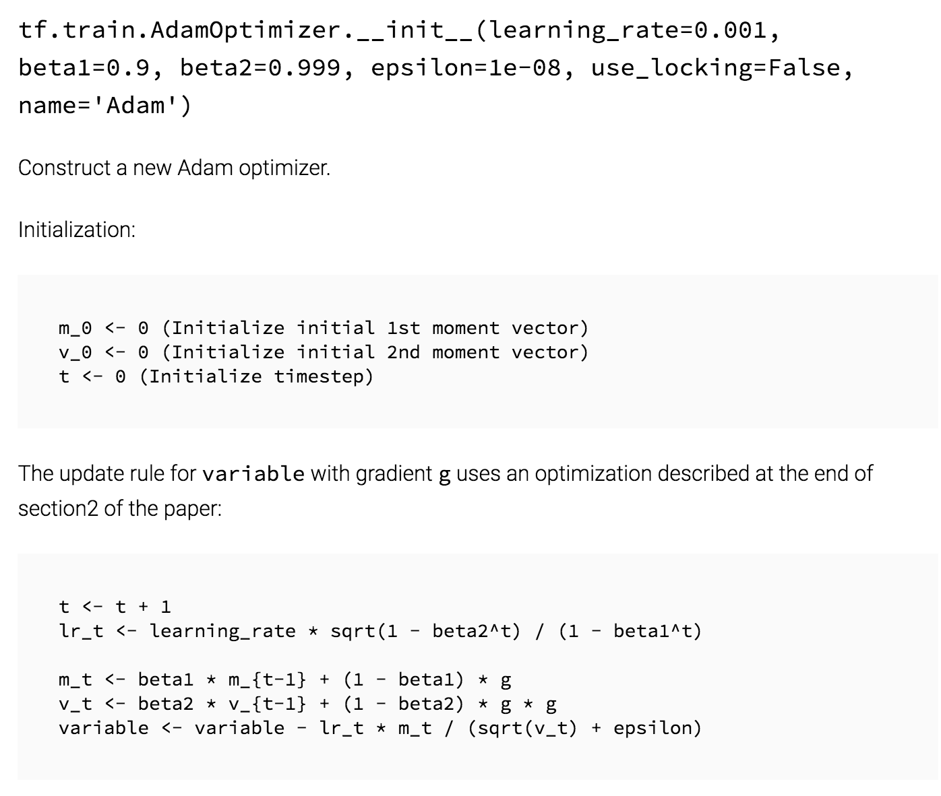
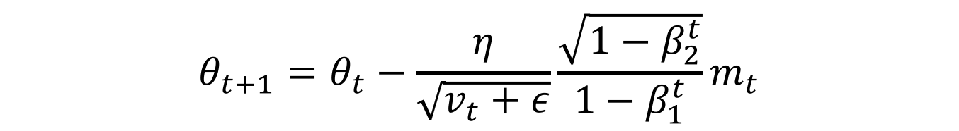
Adam
Adaptive Moment Estimation (Adam) stores both exponentially decaying average of past gradients and and squared gradients.
$$m_{t}=β_{1}m_{t−1}+\left(1−β_{1}\right)g_{t}$$
$$v_{t}=β_{2}v_{t−1}+\left(1−β_{2}\right)g_{t}^{2}$$
$$θ_{t+1}=θ_{t}−\frac{η}{\sqrt{v_{t}+ε}}{\frac{\sqrt{1−β_{2}^{t}}}{1−β_{1}^{t}}m}_{t}$$

Slide 25


Visualization

Slide 26
Which optimizer to use?
Use adaptive learning rate methods (Adagrad, Adadelta, RMSprop, Adam)
Adagrad decreases the learning rate of more activated features.
RMSprop extends Adagrad by dealing with radically diminishing learning rates (=Adadelta).
Adam adds bias-correction and momentum to RMSprop.

Slide 27
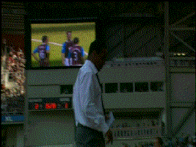
Additional strategies

Slide 28
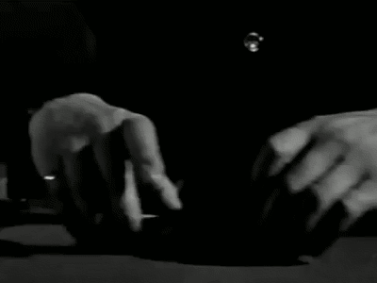

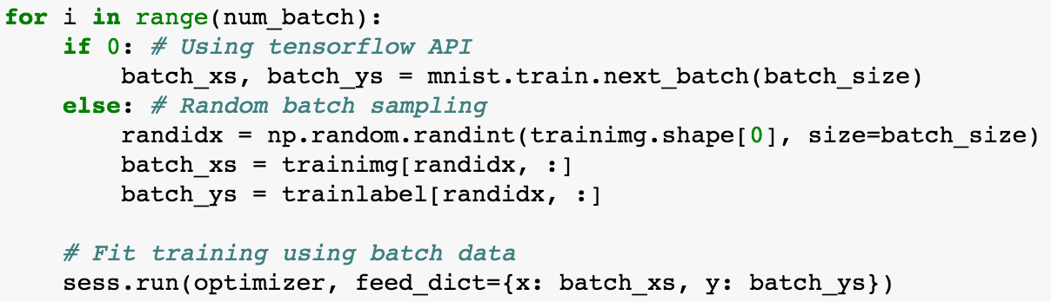
Shuffling

Slide 29
Curriculum Learning

Slide 30
Batch normalization

Slide 31
Early stopping

Slide 32

Gradient noise

Slide 33

Learning rate

